Slide 1
“Understand the Airport delays and cancellations. Identify the key trends and the root cause for the delays”
PROJET TEAM # 2
TEAM MEMBERS
Satya Madakshira
Trevor Prescott
Gibraan Negron
Ashish Shrivastava

Slide 2
Agenda
Introduction
Project Description and Key Analysis
Datasets and Terminologies
Key Findings
Technical Approach
Q&A

Slide 3
INTRODUCTION
“Flight delays are an inconvenience to the passengers. A delayed flight can be costly to passengers by making them late to their personal scheduled events and commitments. A passenger who is delayed on a multi-plane trip could miss a connecting flight. Anger and frustration can occur in delayed passengers.”
According to Wikipedia, A flight delay is when an airline flight takes off and/or lands later than its scheduled time. The Federal Aviation Administration (FAA) considers a flight to be delayed when it is 15 minutes later than its scheduled time. A cancellation occurs when the airline does not operate the flight at all for a certain reason.
Cost to Airlines (according to Wikipedia)
In the United States, the Federal Aviation Administration estimates that flight delays cost airlines $22 billion yearly.^{[8]} Airlines are forced to pay federal authorities when they hold planes on the tarmac for more than three hours for domestic flights or more than four hours for international flights.^{[4]}
*** Source : Wikipedia

Slide 4
Project Description and Key Analysis
Project Description:
Airport delays and cancellations are often very frustrating for the passengers and most of the time airline operator doesn’t provide the true reasons for the delays.
We will look to build a correlation and trends in airline delays and try to identify the root cause for these delays and if they are related to extreme weather, airline operator, traffic volume, population/density, etc.
Research Questions to Answers:
Does the airport delays are due extreme weather?
Delays are subjected to size the of the airport?
Cost of the delays to the airlines?
Delays by Airline Operator?

Slide 5
Dataset
The data set used for this project was downloaded from the American Statistical Association. The data originated from the U.S. Department of Transportation's (DOT) Bureau of Transportation Statistics (BTS) that tracks the on-time performance of domestic flights operated by large air carriers.
Summary information on the number of on-time, delayed, canceled and diverted flights appears in DOT's monthly Air Travel Consumer Report, published about 30 days after the month's end, as well as in summary tables posted on their website.
Dataset used in the project was from 2010 to 2016
In addition, top 10 busiest airport was sourced from Wikipedia
*** Source : http://stat-computing.org/dataexpo/2009/the-data.html

Slide 6
Key Terminology
Carrier Delay
Carrier delay is within the control of the air carrier. Examples of occurrences that may determine carrier delay are: aircraft cleaning, aircraft damage, awaiting the arrival of connecting passengers or crew, baggage, bird strike, cargo loading, catering, computer, outage-carrier equipment, crew legality (pilot or attendant rest), damage by hazardous goods, engineering inspection, fueling, handling disabled passengers, late crew, lavatory servicing, maintenance, over sales, potable water servicing, removal of unruly passenger, slow boarding or seating, stowing carry-on baggage, weight and balance delays.
Late Arrival Delay
Arrival delay at an airport due to the late arrival of the same aircraft at a previous airport. The ripple effect of an earlier delay at downstream airports is referred to as delay propagation.
NAS Delay
Delay that is within the control of the National Airspace System (NAS) may include: non-extreme weather conditions, airport operations, heavy traffic volume, air traffic control, etc. Delays that occur after Actual Gate Out are usually attributed to the NAS and are also reported through OPSNET.
Security Delay
Security delay is caused by evacuation of a terminal or concourse, re-boarding of aircraft because of security breach, inoperative screening equipment and/or long lines in excess of 29 minutes at screening areas.
Weather Delay
Weather delay is caused by extreme or hazardous weather conditions that are forecasted or manifest themselves on point of departure, enroute, or on point of arrival.
*** Source : Federal Aviation and Administration

Slide 7
Key Findings and analysis # 1
The graph shows the total flight delay for each reason from 2010 to 2016
Key Findings
Late Aircraft is biggest cause for the delays in 7 years (2010 to 2016) and the airport security was the lowest reason for the delay
2013 and 2014 happen to be the worst years in airport delays between 2010 - 2016

Slide 8
Key Findings and analysis # 2
The graph shows the total flight delay by month from 2010 to 2016
Key Findings
Summer (June to August) happen to have the maximum delays

Slide 9
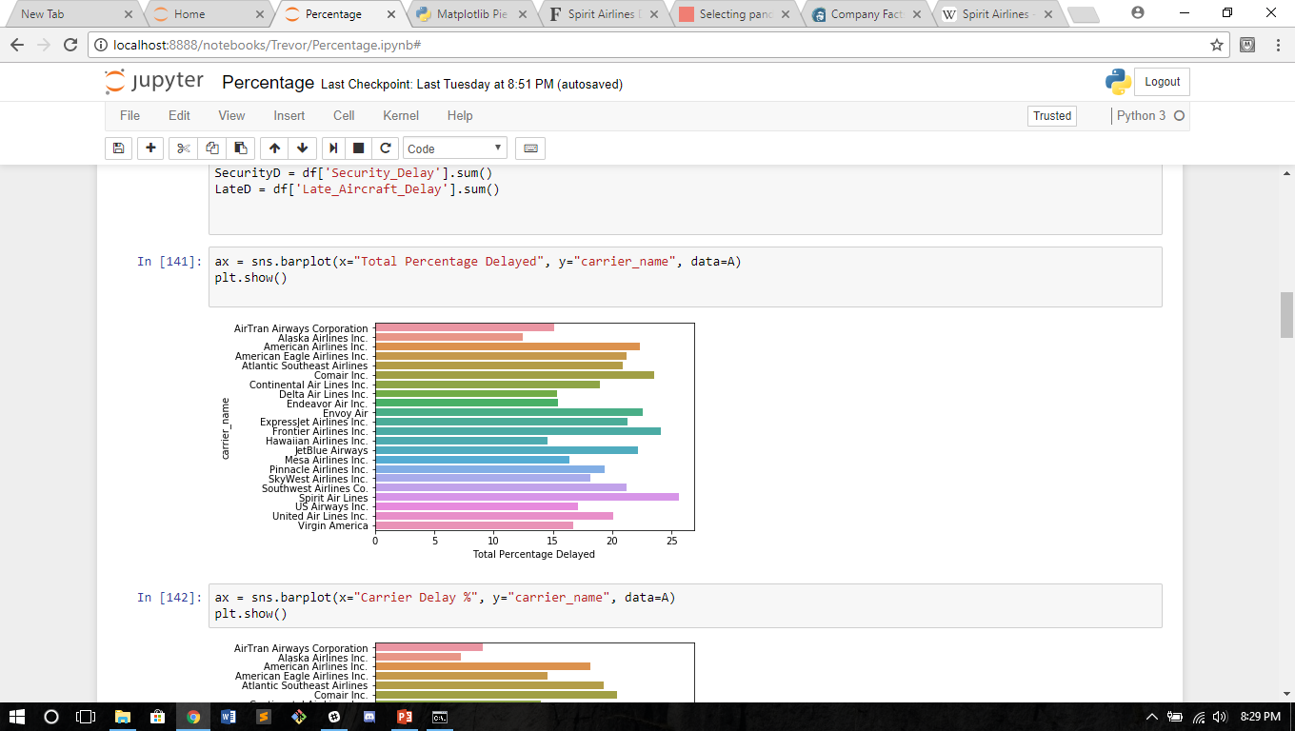
Total Percentage Delayed based on air line
Key Findings and analysis # 3
We calculated the percentage of delays from total arrivals for each air carrier.
Key Findings
Spirit Airlines had the largest delays running over 25 %
Whereas Alaska, Hawaiian and AirTran Airways had below 15%

Slide 10
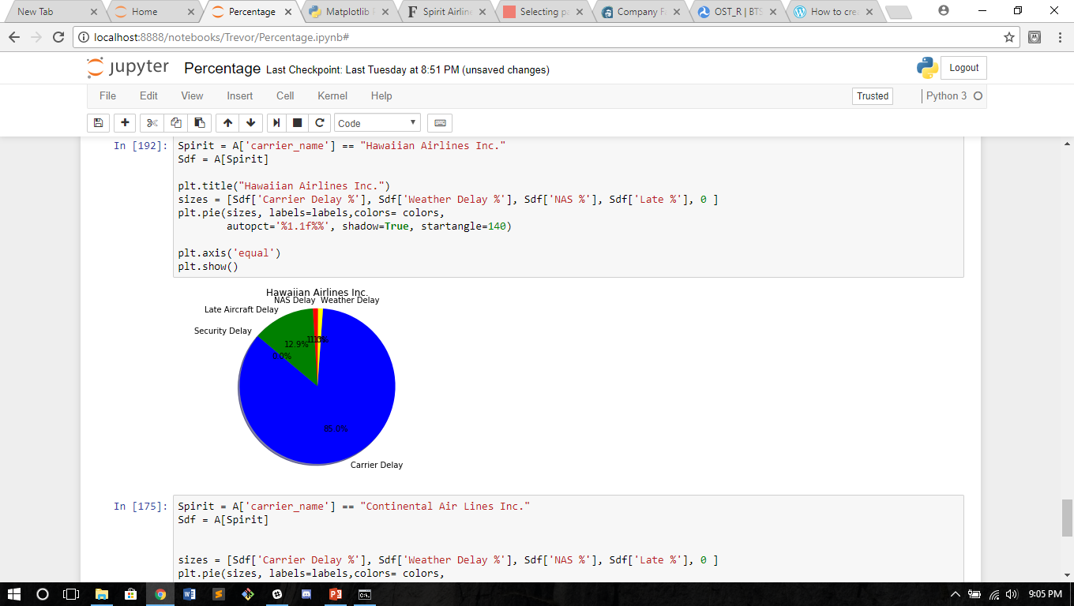
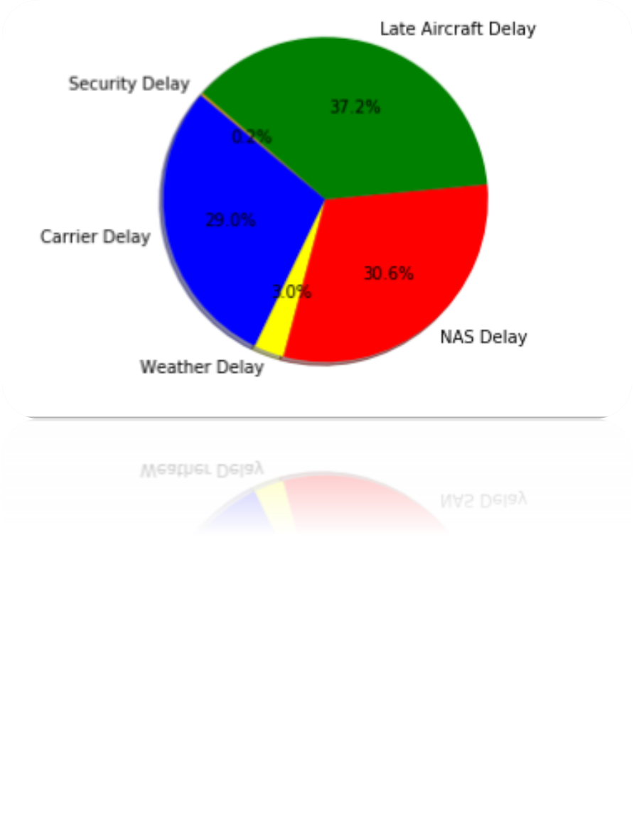
Hawaiian Airlines
Key Findings and analysis # 4
Hawaiian Airlines has a weird distribution.
We are uncertain of why the delay
Perhaps the have a carrier delay even in the case of a NAS delay?

Slide 11
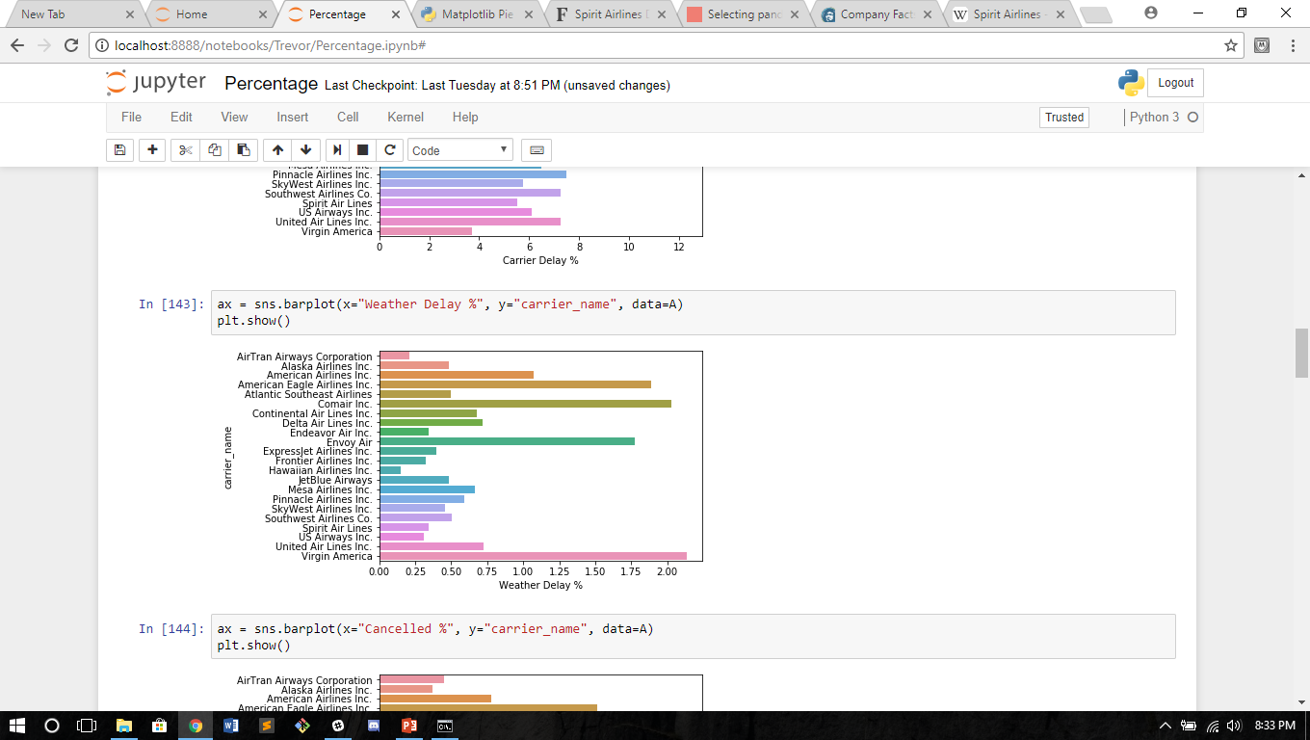
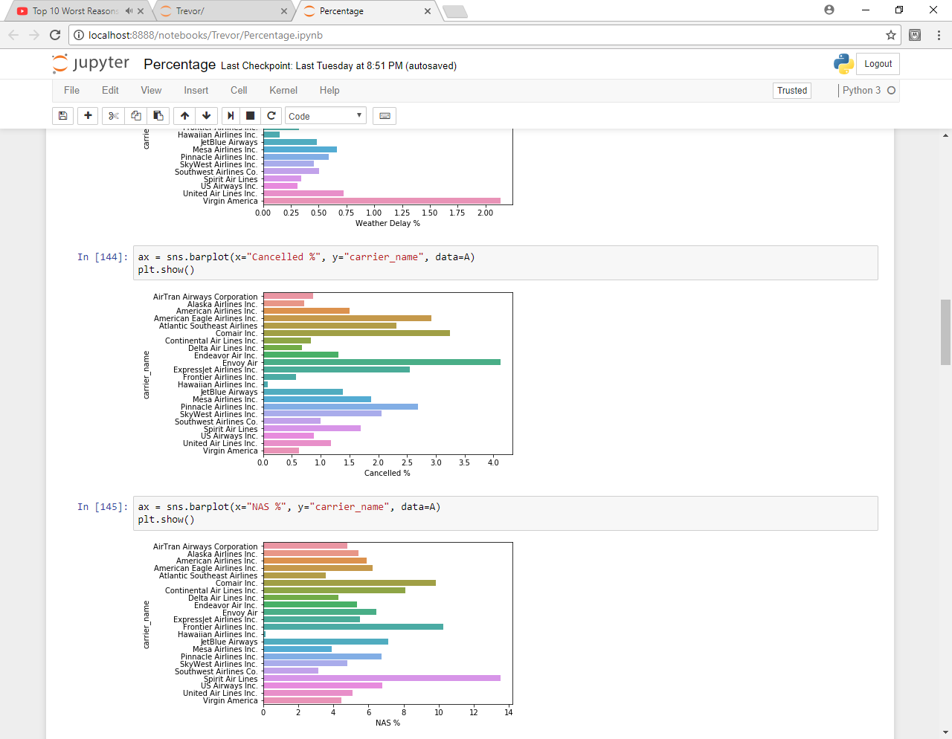
Percentage delay for Weather and Cancelations
Key Findings and analysis # 5
We calculated the percentage of delays from Weather and
Cancellation for each air carrier. Assuming that cancelation were largely caused from weather related issues.
In large part the trend holds particularly American Eagle Airlines, Comair Inc., and Envoy
Virgin America seems a significant outlier.

Slide 12
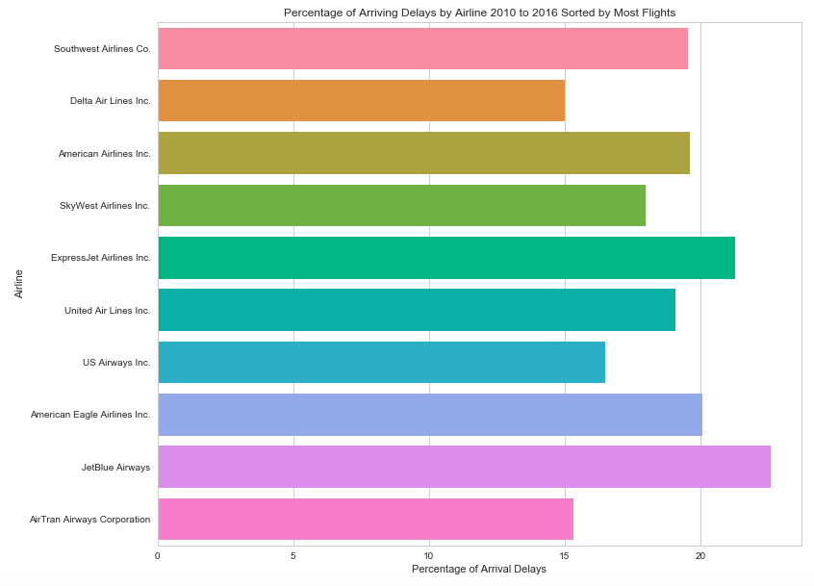
Key Findings and analysis # 6
This bar graph shows the percentage of arrival delays for the 10 largest carriers based on the number of flights. The Airline List is sorted in descending order based on number of total flights
Key Findings
This graph shows that the number of flights is not a key factor in delays
The Number Five and Number Nine Airline have the highest percentage of delays based on total operations

Slide 13
Key Findings and analysis # 7
The graph shows the total flights delay in US Top 10 Busiest Airport
Key Findings
Atlanta and Chicago O’hare are the Top 2 airport that had most flight delays and Seattle and Charlotte had least delays

Slide 14
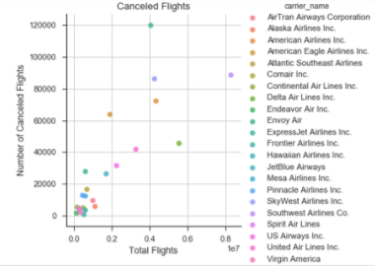
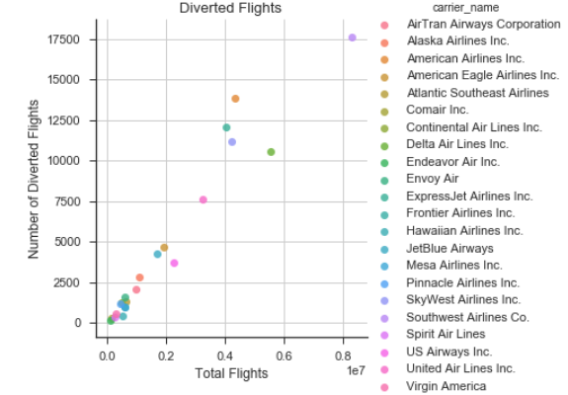
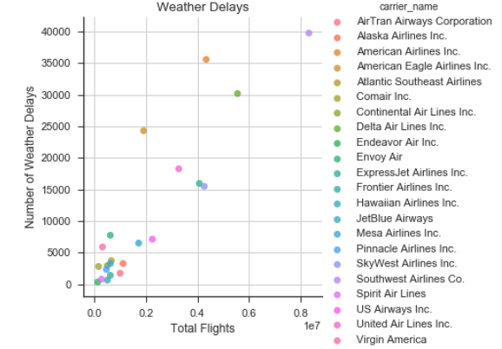
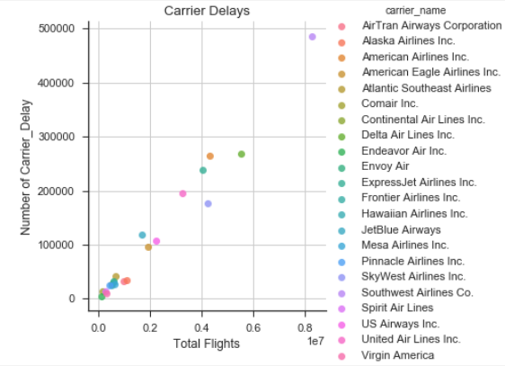
Key Findings and analysis # 8
These graphs show scatter plots of the number of delays and flights by airline. Each graph shows the number of delays based on different causes
Key Findings
These show a linear increase with the number of delays and the number of operations

Slide 15
Key Findings and analysis # 9
Linear regression comparing total flight delays with the flight delays due to weather
Key Findings
As # of flight delays increase over 100K, the reason for those delays are other than weather

Slide 16
Key Findings and analysis # 10
The graph shows the total flight delays by Year
Key Findings
Violin plots have many of the same summary statistics as box plots:
the white dot represents the median the thick gray bar in the center represents the interquartile range the thin gray line represents the 95% confidence interval
Thickness of the violin plot shows the density

Slide 17
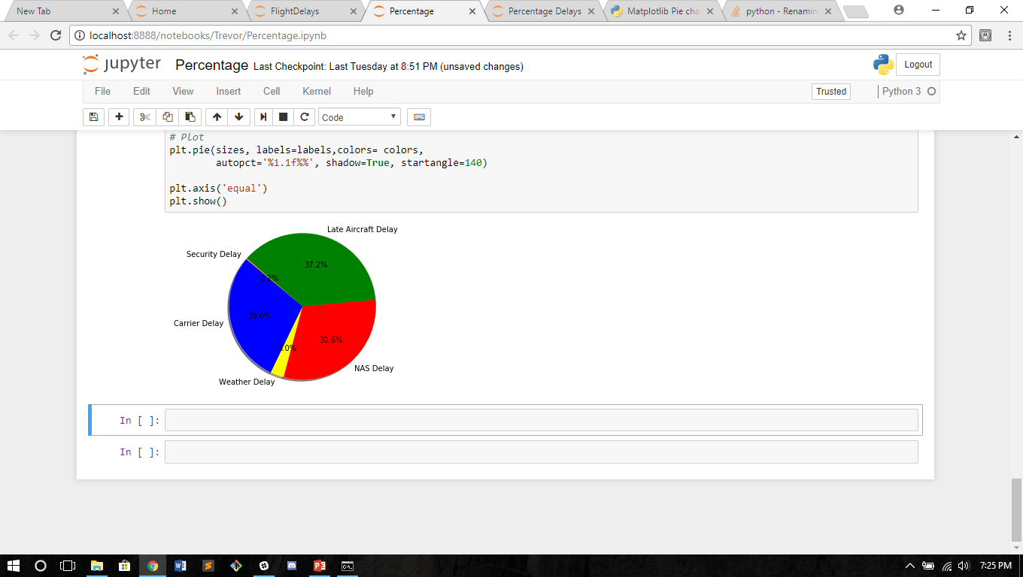
Percent Reasons for Delays
Key Findings and analysis # 11
The pie chart breakdowns the causes for flight delays based on 22 separate airlines from 2010 to 2016
Key Findings
We find that the primary causes of flight delays occur from Carrier, NAS, and Late Aircraft Delays
Weather and Security Delays take up less than 3.3 % of all delays.

Slide 18
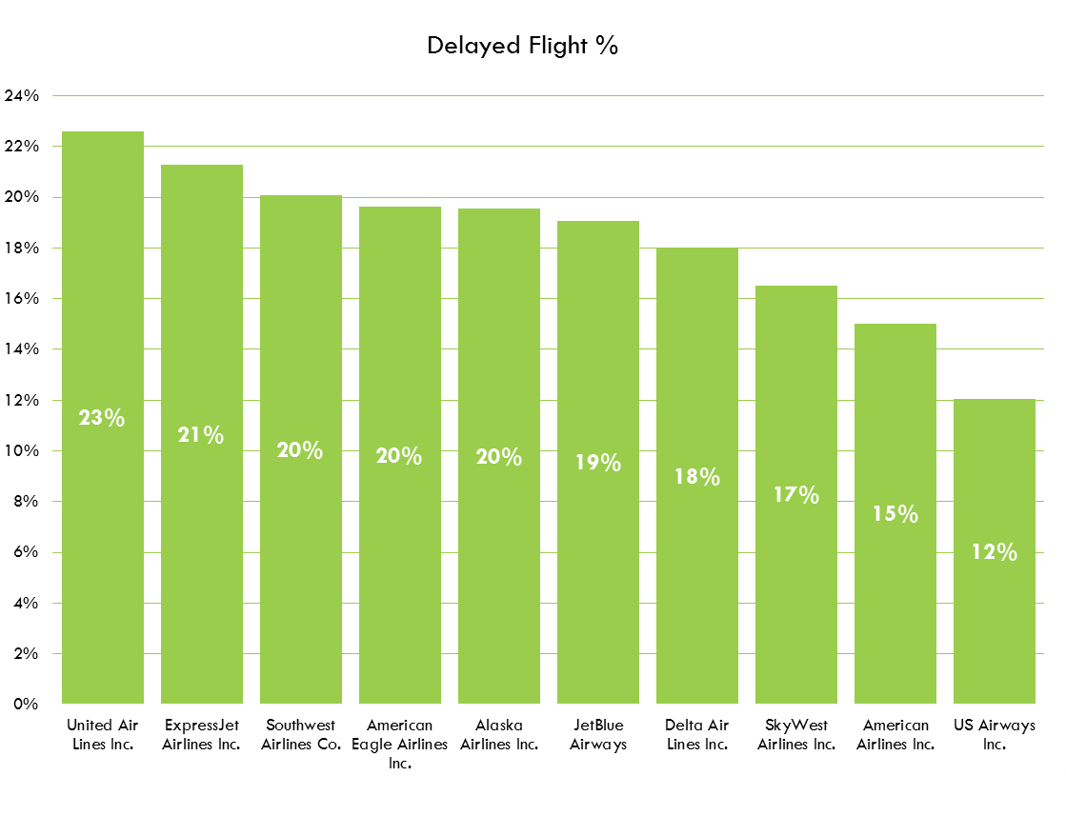
Key Findings and analysis # 12
The graph shows the Airlines with the highest number of flight delays
Key Findings
19% of flights of Top 10 Airlines were delayed during the analysis period.
United Airlines had the highest % of Delayed flights

Slide 19
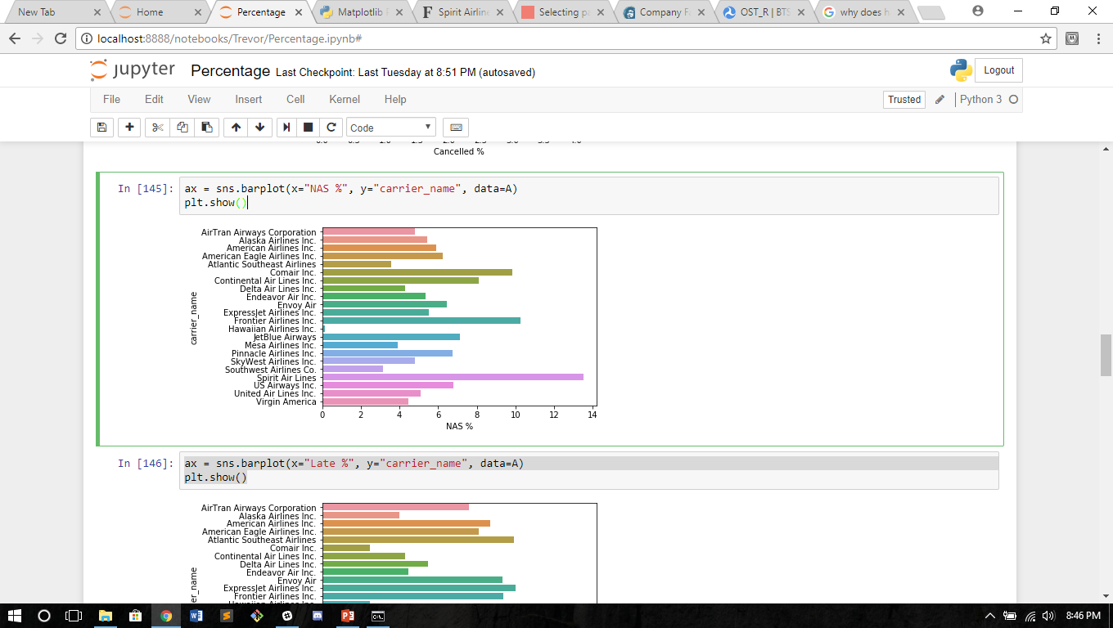
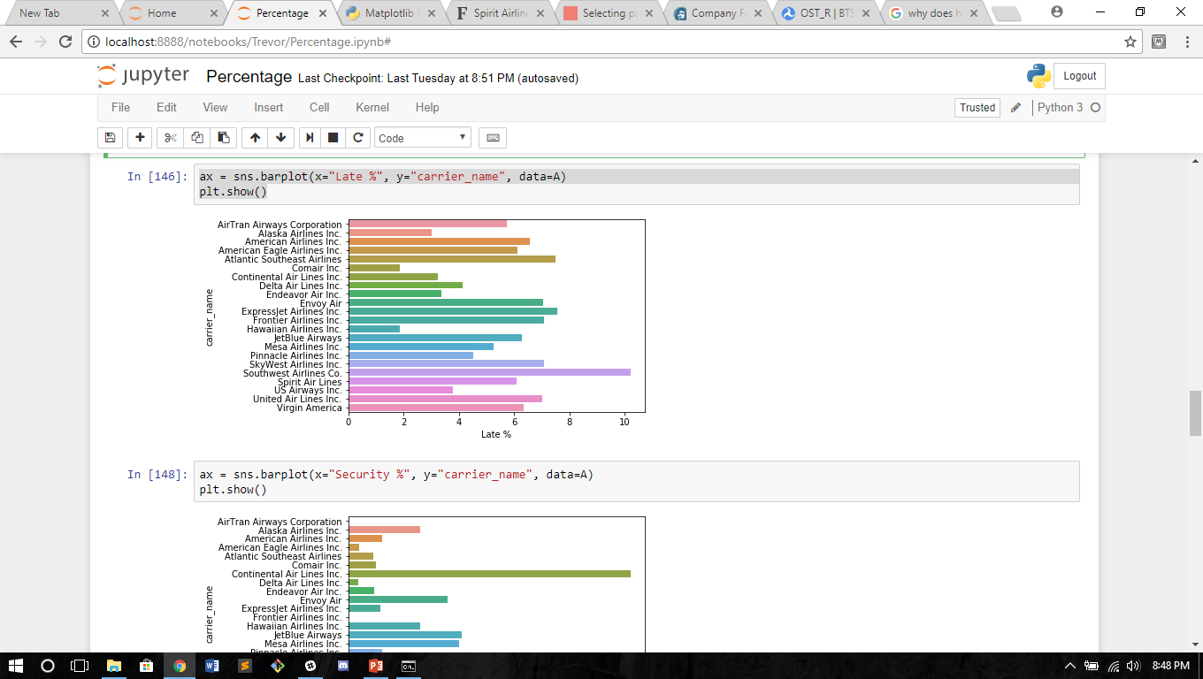
Nas Delays and late arrivals
Key Findings and analysis # 13
We continued our research with NAS delays and late arrivals.
Key Findings
Spirit airlines primary problem seems to be in NAS delays
Southwest has a large amount of late arrivals.

Slide 20
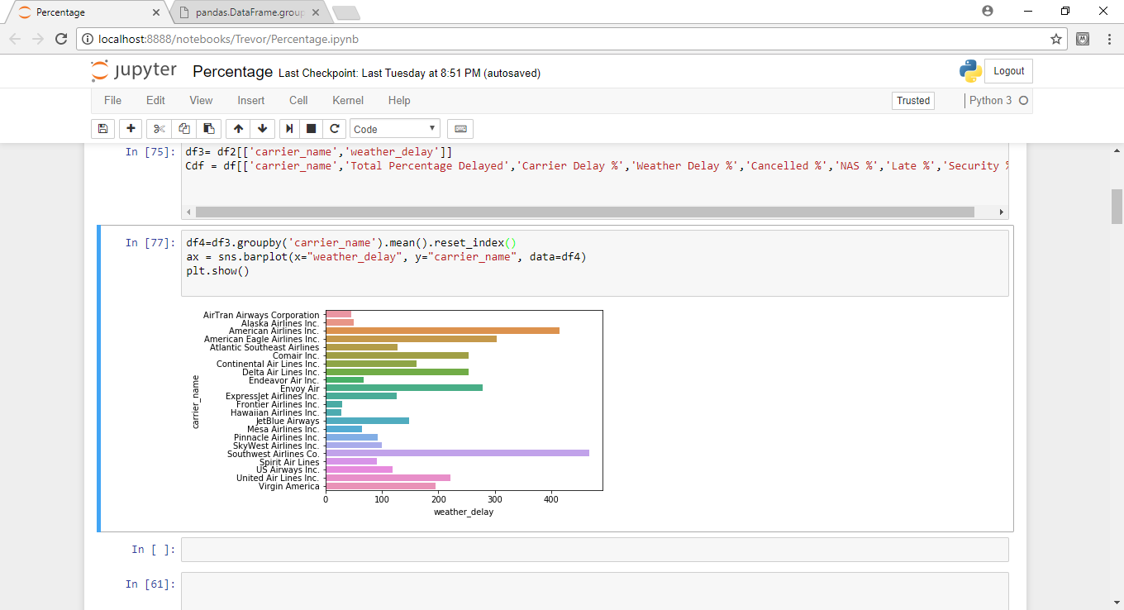
Further Investigation
Key Findings and analysis # 14
To investigate our finding, we checked if Virgin airlines was more willing to have longer delays instead of canceling.
After taking the average delay from weather in minutes we found again Virgin is remarkably low.

Slide 21
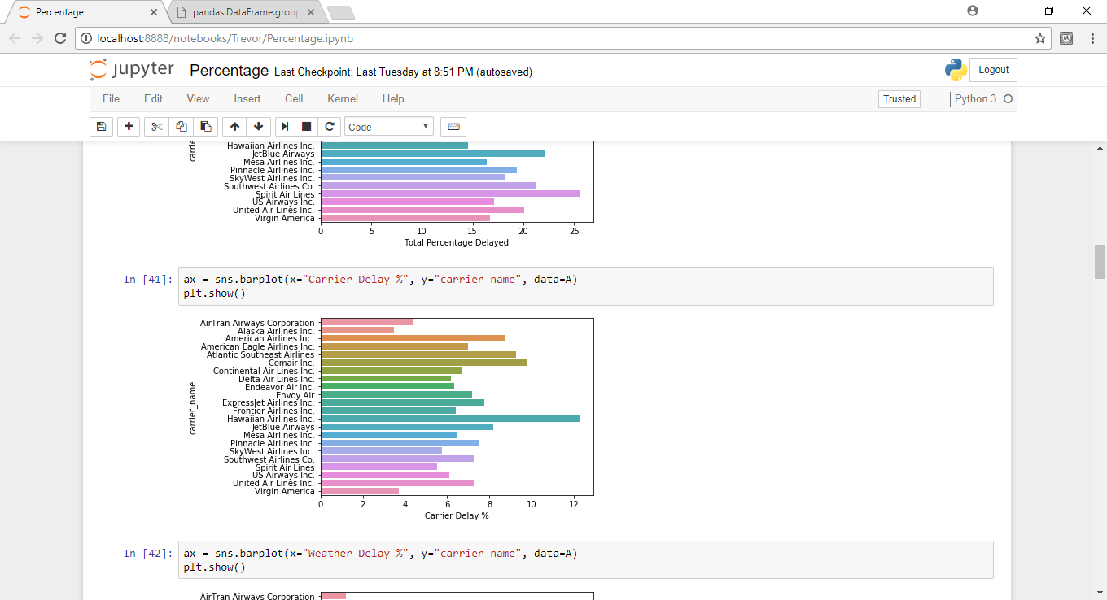
Carrier Delays
Key Findings and analysis # 15
This is on category Spirit does well in.
Some top performers in other categories struggle with this. Probably due to the quality of clean up.

Slide 22
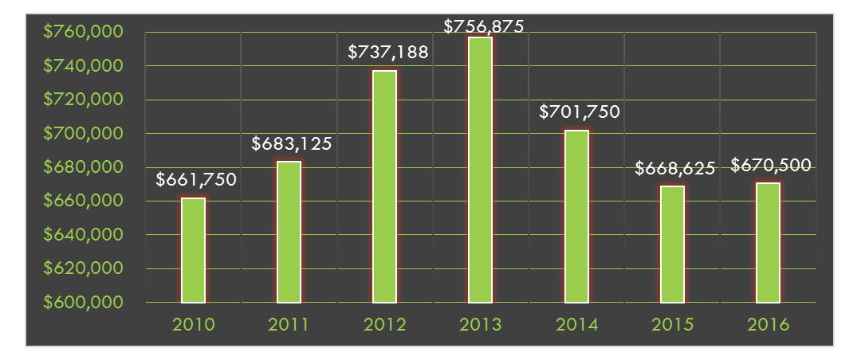
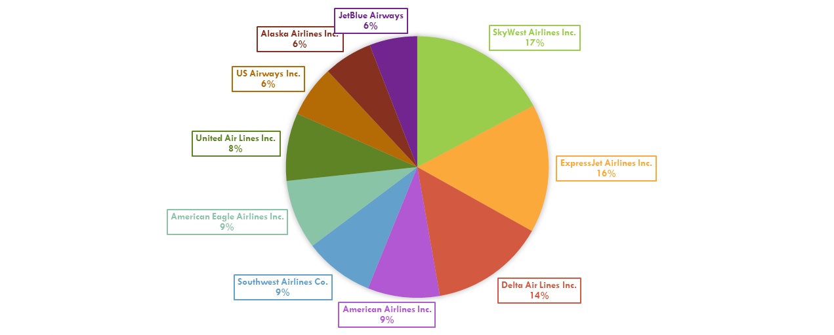
Key Findings and analysis # 16
The graph shows the financial Impacts due to delayed flights
Key Findings
Using DOT’s Standard Definition for 2016 ($ 62.5 per minute)
Top 10 Airlines incurred the highest costs due to Flight Delays in 2013
SkyWest Airlines, ExpressJet Airlines Inc. and Delta Airlines were the Top 3 contributors
http://airlines.org/dataset/per-minute-cost-of-delays-to-u-s-airlines/

Slide 23
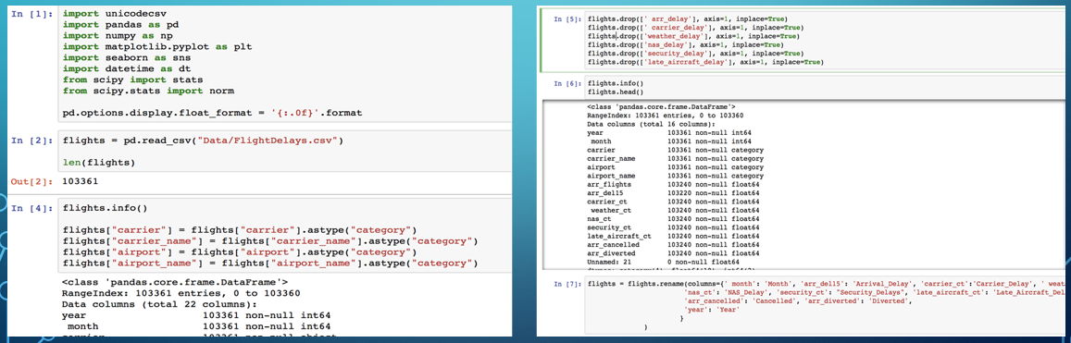
Technical approach
Utilized the following Python packages
Pandas - For data load, data preparation, cleansing, indexing and grouping
Matplotlib.pyplot - Visualization
Seaborn - for advance visualization and statistical graphics

Slide 24
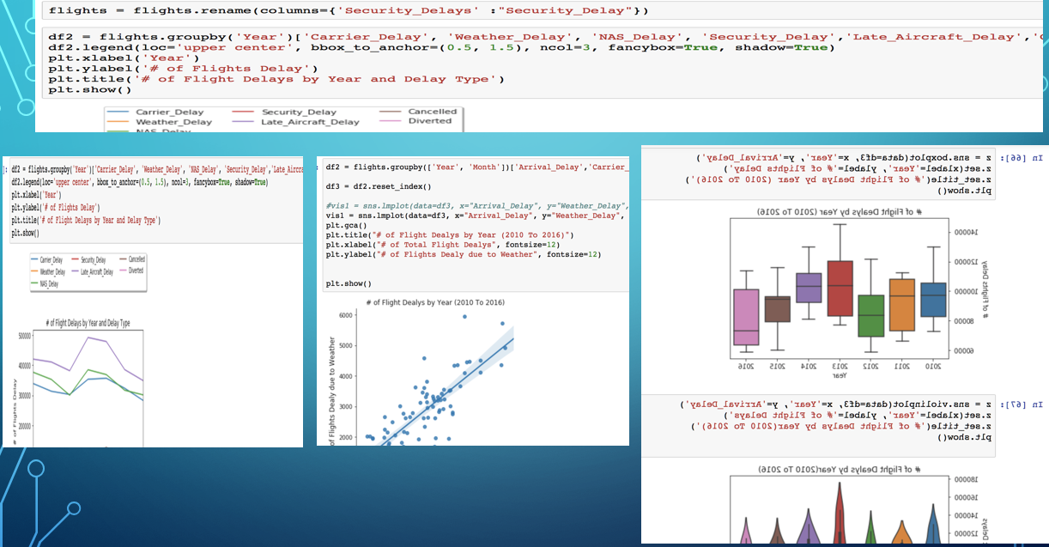
Technical approach

